Slide 1
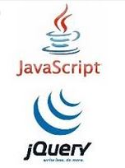
JavaScript and jQuery Course
Session 01

Slide 2
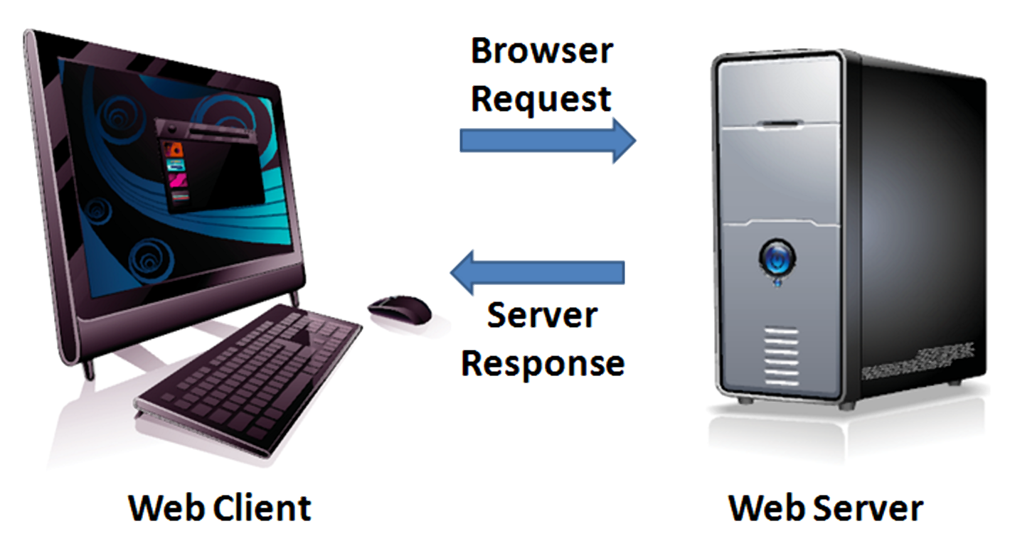
Client / Server Model
Client – Web Browser
Server – Web Server

Slide 3
Client Sided Technologies
Interpreted in browser
HTML
CSS
JavaScript
Processed on Server
PHP
ASPX
JSP

Slide 4
Example HTML5 Web Page
<!DOCTYPE html>
<html>
<head>
<meta charset="utf-8">
<title>Page Title Goes Here</title>
</head>
<body>
... body text and more HTML5 tags go here ...
</body>
</html>

Slide 5
Basic HTML5 Syntax
<img src="dog.jpg" alt="Photo of my dog">
element
atttribute
value

Slide 6

Basic CSS Selectors
#one {width: 50%;}
.red {color: red;}
p {line-height: 1.5em;}
#one b {font-style: italic;}
<p id="one" class="red">
My dog is <b>very</b> big!
</p>

Slide 7
What is JavaScript?
Scripting language – browser
Case Sensitive
Cross platform
Object oriented
Loosely typed
Standardized by ECMA
Not Java
Client-sided

Slide 8
History of JavaScript
1996 LiveScript – Netscape
Netscape 2.0 – JavaScript
2000ish - AJAX
Today - Frameworks

Slide 9
How JavaScript Fits In
HTML – content layer
CSS – presentation layer
JavaScript – behavior layer

Slide 10
Tools
Plain text editor
HTML Editor – Adobe Brackets
IDE – Aptana Studio (not using)
Online Tools
Browser Developer Tools

Slide 11


Terminology
Graceful degradation building a site with extra features first then writing code for sites that do not support them
Progressive enhancement – usability for all! building a site with the basic features first then adding features for sites that support them
Unobtrusive JavaScript separation of the JavaScript from the content

Slide 12
Object Oriented
objects - what we work with
properties - object’s characteristics
methods - things an object can do
events - things that happen to an object

Slide 13
Browser Object Model
Browser Object Model or BOM
Traditional – built in browser objects
window
document
Math
Date

Slide 14
Document Object Model
Document Object Model or DOM
Standardized by W3C
Hierarchy of the page elements
Not part of JavaScript
Hard to use – replaced by frameworks

Slide 15
Writing JavaScript Code
Embedded – head or body
<script type="text/javascript">
JavaScript Goes Here
</script>
Optional HTML attribute

Slide 16
Writing JavaScript Code
External – head or body
<script type="text/javascript"
src="file.js">
</script>
Indicates external file
HTML atribute

Slide 17
Writing JavaScript Code
For browsers that don’t support JavaScript <noscript>
</noscript>

Slide 18
JavaScript Syntax – Comments
// single line
/*
multiple line
comment on
several lines
*/

Slide 19
Comments – Example

Slide 20
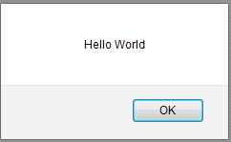
JavaScript Syntax – How to write
Dot syntax
window.alert()
Statements end in semicolon
alert("Hello World");
A method is followed by ( ) and may contain information

Slide 21
JavaScript Syntax – How to write
<head>
<meta charset="utf-8">
<title>The alert method of the window object</title>
<script>
alert("Hello World");
</script>
</head>

Slide 22
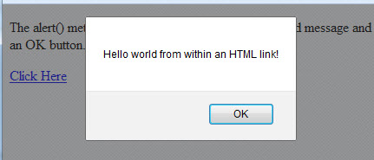
Traditional JavaScript – Don’t Use
<body>
<a href="#"
onclick="alert('Hello world from within an HTML link!');
return false;">Click Here</a>
</body>

Slide 23
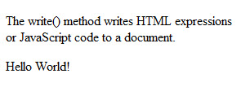
Traditional JavaScript – Don’t Use
<body>
<script>
document.write("Hello World!");
</script>
</body>
The write method of the document object

Slide 24
Document Object Model
Allows us to write to the page using “unobtrusive JavaScript”
Replaces document.write()

Slide 25
Document Object Model Basics
<head> <script>
document.getElementById("xyz")
</script>
</head>
<body>
<p id="xyz"> </p>

Slide 26
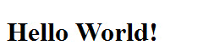
DOM – anonymous function
Because we are referencing an ID in the body section, we need to wait until the page has loaded to execute the JavaScript.
The onload event does this.
<head>
<script>
window.onload = function() {
document.getElementById('heading1').innerHTML = 'Hello World!';
}
</script>
</head>
<body>
<h1 id="heading1"> </h1>
innerHTML is a property of the element with the ID that allows us to write content.

Slide 27
DOM – named function
<head>
<script>
function init() {
document.getElementById('heading1').innerHTML='Hello World!';
}
window.onload = init;
</script>
</head>
<body>
<h1 id="heading1"> </h1>

Slide 28
How to create identifiers
Identifier
The name we give to a variable, method, property, function, object
Camel casing syntax
All of the words, except the first word, start with a capital letter.
Example: firstName
Underscore notation
All of the words are joined by an underscore
Example: first_name

Slide 29
Identifiers continued
Rules for naming identifiers
Begin with a letter, the $ character, or the underscore (_)
Cannot begin with a number but can contain a number
Cannot contain spaces, punctuation, mathematical or logical operators
Cannot be JavaScript reserved words

Slide 30
Identifiers – JS Reserved Words
abstract | else | instanceof | switch
boolean | enum | int | synchronized
break | export | interface | this
byte | extends | long | throw
case | false | native | throws
catch | final | new | transient
char | finally | null | true
class | float | package | try
const | for | private | typeof
continue | function | protected | var
debugger | goto | public | void
default | if | return | volatile
delete | implements | short | while
do | import | static | with
double | in | super

Slide 31
Conclusion
A good way to test and debug your code is by using an alert() and using the Browser tools F12 key
Learning how to use an alert and to
write to the page using the Document Object Model
are the most important concepts to learn this week!

